Slide 1
Incremental Application Modernization
Coenie Vermaak
Systems Architect – Britehouse Automotive (Automate)

Slide 2
Content
Why Modernize – Important considerations to help select the right approach
Understanding YOUR modernization project and scope
Traditional versus Incremental Modernization
Benefits, Risks and Challenges
Complexities
Toolset Considerations
Development Environment and Deployment
Roadmap Planning and Resource Management
Merging Modernized Code into Daily Business
Conclusion
Important Considerations
Where to start?

Slide 3
Why Modernize – Important considerations to help select the right approach
Reason | Description
Technical Debt | A metaphor referring to the eventual consequences of poor system design, software architecture or software development within the code base
Technology Upgrade | It’s vital to remain closely aligned with the roadmap of technology vendors in order to remain relevant and responsive in the ever-evolving technology landscape
Architecture Upgrade | Ensure that the fundamental structure of your software supports the roadmap and vision for the product. Once implemented, it is costly to change and can severely hamper the efficiency and effectiveness of your product
Interoperability | The capability to communicate, execute programs, or transfer data among various functional units, in a manner that requires the user to have little or no knowledge of the unique characteristics of those units
People and Process | Ensure that the current development paradigm and skillset does not hamper innovation and timeous response to market requirements
Extensibility | Does the level of effort and cost required to extend the system outweigh the benefits of the extension
Notes:
One of the major reasons that modernization projects fail is because the reasons for the modernization project have not been clearly defined and articulated.
If the only reason to start a modernization project is to upgrade to a newer technology then doing a traditional modernization project will suffice, there is no reason to add the complexities of a granular incremental approach
If however, it is required to make major changes to the system architecture, then it will be desirable to make the changes incrementally thereby not destabilizing the entire system
A necessary evil of the granular incremental approach is potentially causing technical modernization debt by continuing development on the Legacy system. This intentional technical debt must be carefully managed to ensure that a balance is drawn between the modernization efforts and customer requirements
A trend that we noticed during the initial phases of the project was that if the scope of work was not contained to a granular level, the testing effort and instability caused in the system increased exponentially.

Slide 4
Understanding YOUR modernization project and scope
Important considerations before any actual modernization is done
Is it required to upgrade only a single component or system
In this case it is feasible to initiate a “Standard” modernization project, that is – plan, design and implement. It is more than likely a once-off effort that will achieve the desired result
If however it is required to create a platform, and incorporate a process, that fosters continuous modernization it is important to understand:
There is a greater scope that must be addressed:
Define a strategy on how “Modernization” changes will be introduced
Define and implement the platform and processes required to support the strategy
The “Modernization” aspect can be considered to be a POC to prove that the framework, structures and processes implemented support the strategy
“Modernization” efforts must be merged with daily operations as soon as possible

Slide 5
Understanding YOUR modernization project and scope
Important considerations before any actual modernization is done
Are you modernizing software in a single business or are you modernizing software that is deployed to a vast customer base?
If the software reside in a single organization, it is easier to manage the risks and the commitment
If however the software is deployed to multiple sites, the following also become important
How is the software deployed?
Is it possible to have different versions at different customers?
What is the effect on the customer base when software must be rolled back?

Slide 6
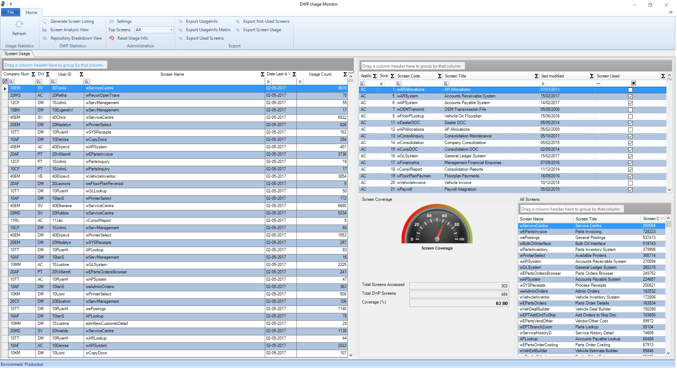
Where to start?
Understanding usage patterns of the application
  Which modules, screens or processes are
  used most often?
  Which screens are not used at all?
  Provides a focused platform to analyze
  performance issues
Understanding user patterns
  Is it possible or feasible to modernize the
  entire “view” for a group of users?
Implement a different billing system?
  Tracking the application at this level allows
  for implementing a different billing model
Additional information from the tool
Full usage report per screen per company
Full usage report per screen per user
Report of all used screens
Report of all unused screens
Report indicating the full count of used screens
Report indicating a spider diagram view of all source code dependencies of a screen

Slide 7
Traditional versus Incremental Modernization
Traditional Modernization | Incremental Modernization
Coarse grained approach, generally focusing on Application or Modular level | Fine grained approach, considered at functional or process level
Tend to be long delivery cycles, governed by rigid traditional project methodologies, costing methods and procedures | Short delivery cycles governed by agile project methodologies
“Big-Bang” release to market. The release(s) tend to be extended periods from the start of the project causing delayed responsiveness | Frequent small releases that ensure constant validation and relevance in the market
Resources tied up for extensive periods | Smaller increments provides more flexibility in resource allocation
Could be challenging to change focus and direction of the project | Fairly easy to change direction based on business and market requirements
Somewhat easier to back out of the project by removing or stopping development of major components | Once implemented, the complexity of the application landscape is increased and therefore not trivial to revert

Slide 8
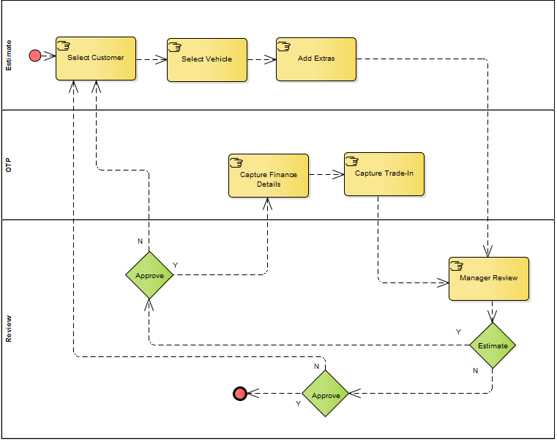
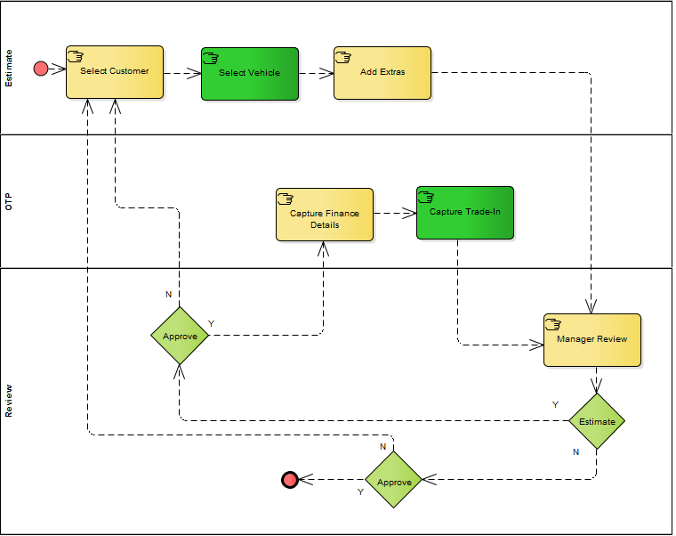
Traditional versus Incremental Modernization
Traditionally a process will be analyzed, designed and implemented in its
entirety. The process considered in this example is a high-level process flow
for creating a vehicle estimate.
Modernizing using the incremental approach you would typically find a smaller
Sub-process and refactor only this process. We selected the sub-processes
by considering:
The number of bugs contained in the process
Possible performance issues
Value-add to end-users by introducing modern technologies
Possible re-use of the sub-process in the greater process

Slide 9
Benefits, Risks and Challenges of Incremental Modernization
Benefits
Depending on the size of your development team, multiple pain points can be addressed simultaneously
Can be addressed side-by-side with legacy development efforts
Pace of implementation can be scaled up or down as required
Easier to manage cost, budget and risk when working in smaller increments
Incrementally derive earlier benefits from the project

Slide 10
Benefits, Risks and Challenges of Incremental Modernization
Risks
Once started and deployed you are committed, not financially viable to undo efforts
Development efforts on the legacy system must be controlled
Possible training and skillset required by current development team
Development Capacity
Notes:
Risks:
The ideal model is to stop new development and major bug fixing efforts on the legacy system. In practice however this is not really possible, unless the development capacity exists to take on project work as well as refactoring of existing legacy code.
Training and upskilling of staff turned out to be a major issue for us, the small size of the development teams made it really difficult to stop development for resources to attend training sessions. On the other hand, the amount of training that is required made it impossible to stagger the training as this will cause development cycles to be extended for a very long time.
Development capacity problem was initially resolved by outsourcing the development to the Wayfare team in Romania.
The difficulty with the outsourced model was that initially the system domain knowledge was lacking and local resources was very often too tied up in operational issues to provide the required support.
All things being equal, the outsourced model with the Wayfare team worked exceptionally well as they played a vital part in laying the foundation for the continuation of the modernization project

Slide 11
Benefits, Risks and Challenges of Incremental Modernization
Development and Deployment
Bundling Legacy and Modernized code into single package for testing and deployment
Development support for Testing and Support departments
Knowledge base and documentation of standards and methodologies
Constantly reviewing what has been done and improve where possible – lesson’s learnt
Bridging frameworks to provide unified functionality to end-users
Development resources and skillsets
Challenges

Slide 12
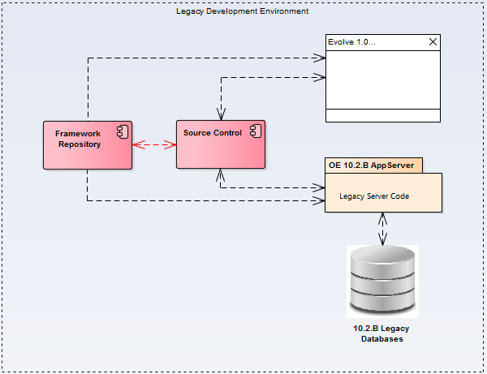
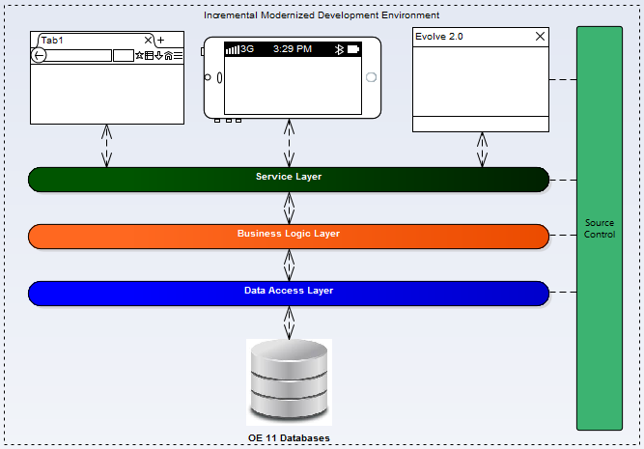
Complexities
Merging environments and frameworks
Upgrading Technical platform
Deploying the legacy and modernized code from Development through the testing environments to production
First Modernized release required new WebClient, SCF and .Net Framework deploys. Big Packages!
Implementing a knowledgebase where design and implementation decisions can be documented
Managing and limiting development efforts on the legacy platform
Phasing the modernization project into the mainstream development cycle
Notes:
Two of the major driving forces behind the modernization project was
Becoming closer aligned to Progress to ensure that we can leverage the latest technologies – to achieve this, we needed to create an efficient and repeatable process to upgrade to new versions of OpenEdge
Created a background downloader process that will do silent downloads of software packages to remote machines so that it is ready when we require it to be
Required a full redesign of our development environment and deployment processes
Removing the dependency on a third-party integration component between the development framework and the source repository
This caused an unexpected by product for our modernization effort. We realized that in fact the scope of the project included modernizing the company as we know it. Various process and procedures had to be adapted to cope with the new requirements. Staff had to be trained to understand the new environments and processes, etc
A major change management effort was required to get people to use and understand the knowledge base that was created

Slide 13
Complexities - Toolset Considerations
Development framework
    Criteria considered for selection:
        Flexibility
        Growth potential, available skillset and support by the vendor and the community
        Fit with desired Architecture
        Total Cost of Ownership
Knowledge Base and Project Management Toolset
Automation
    Automated deployments that are not dependent on technical resources
    Continuous integration
Early in the project it was decided that the initial development effort will be outsourced, therefore the selection of tools
had to satisfy the following criteria:
Enable on-line collaboration
Perform well in a distributed environment
Notes:
We realized very quickly that a major supporting structure will be required to ensure that this project, as well as future modernization projects can be managed and conducted as painlessly as possible
Apart from desired Architecture and future state decisions the following was also mandated for a successful implementation of our project
Selection of an appropriate development framework
The world of frameworks is a complex environment, no framework is good at everything and some are better at most than others
From the start we knew that this process will surely be repeated in the lifetime of the project, therefore the above criteria was deemed to be critical in our selection
Knowledge Base and Project Management Toolset
We required a feature rich toolset, that is easy to use, implement and maintain as well as affordable
Britehouse automotive already implement various similar tools but none that suited the modernization purpose, therefore a platform that is easily extensible was required
Ultimately decided on the Atlassian Toolset: Confluence, Jira, Fisheye and Crucible

Slide 14
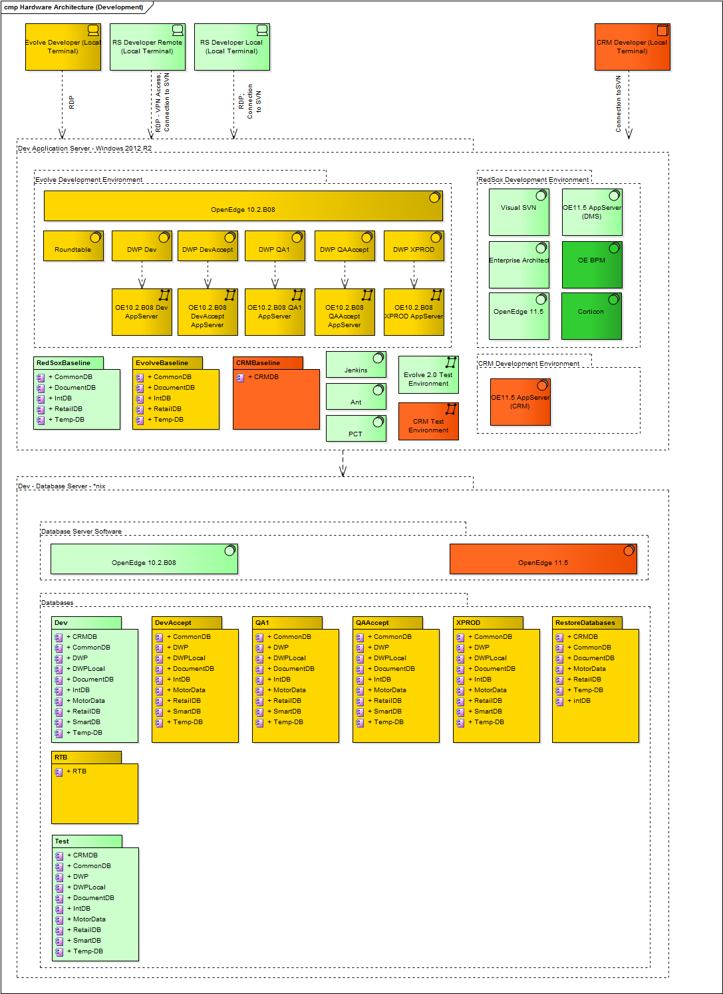
Complexities – Development Environment and Deployment
Development environments tend to become very complex over time
  Deployment process from development into test and production environments had a lot of moving parts
    Environment simplified by automating manual tasks using:
        Jenkins
        ANT
        PCT
Tip:
Very painful lesson we had to learn:
Modernization severely effects your development environment. Plan time to accommodate this

Slide 15
Complexities - Roadmap Planning and Resource Management
    Product Manager / Product owner
    Clearly defined roles for all team members
    Business- and Technical design must be completed and reviewed with developers before development commence
    Accept the fact that if you are fundamentally changing the Architecture of your application, code harvesting will not always be possible in significant proportions
    Include deployment strategy to production in roadmap
    Expect things to be more difficult and time consuming than you think
Notes:
Product Manager / Product Owner
Vital role in determining the modernization points and scope as well as for management of deliverables and release train
Clearly defined roles
Being a small development team, all internal members where used to fight all kinds of fires
Operational issues always gets preference – This takes up a lot more time than what is ideal for any project
All the little things we forgot, had to be handled by the internal team as we went along, often making availability to the outsourced team difficult
If at all possible, ring-fence the modernization team to focus on the project exclusively. If this is not possible, be aware of the fact that things progress will be challenging

Slide 16
Complexities – Merging Modernized code into daily business
    It is not sustainable to continue the modernization projects for extended periods:
      Plan for merging modernization efforts into daily business as early as possible
      Initially complicated development environments will be created, ensure that this is done in a manner that supports refactoring in the modernized platform in a consistent and easy way
      Have a realistic roadmap to ensure the required parts of the system are modernized in an acceptable time frame
What We Want
What We Want To Avoid
Notes:
Why this was difficult for us
Resource and skill limitations
Technical debt and stability of legacy system
Demand from business made it very difficult to control the growth of the legacy system
What we did to minimize the effect
Focused on getting the platform issues and the first iteration of the project resolved and deployed.
Changed focus to continue the modernization as part of daily business
Created bridge with clearly defined interfaces between legacy and modernized code allowing us to “embed” modernized code as part of a legacy process

Slide 17
Where are we now?
What did we achieve
Upgraded production environments to OE 11.5
Implemented a “mostly” automated process that will allow upgrades of OpenEdge without much disruption to end-users
Automated deployment from development to production
Designed and implemented the framework and platform for future incremental modernization efforts
Currently a small team is actively working at modernizing legacy components
Upgraded development environment to OE 11.6

Slide 18
Where are we now?
Was it worth it
The end-users provided very positive feedback on the modernized functionality
Considering a snapshot of the environment before the modernization project and now, the improvements made have streamlined the development and release process substantially
Fundamentally changing the underlying architecture of the application now allows for easier, more structured integration

Slide 19
Where are we now?
Challenges we find difficult to overcome
Upgrading Legacy development environment from OE10.2.B to OE11
Minimizing growth in the Legacy code base
Upskilling development resources in the Legacy Development team
Finally this has been resolved, however, it was only done two years down the line, and has caused rework in some areas of deployment

Slide 20
Important Considerations
Is your company ready for modernization
Most of the companies considering modernization have been around for a long time. Generally this means that the processes and procedures are cemented and staff are comfortable with them.
Change management might be an important part of the modernization project. If the change the modernization project brings is not introduced into your company formally, you might be faced with the following problems:
You could create an ‘Us’ and ‘Them’ culture
Misinformation regarding the project could spread throughout the company and possibly worse, your customer base
Training will most likely be required for a substantial part of the company
If you are introducing new technology, you will have to ensure that your development team has the required knowledge to implement solutions based on that technology
Changing your design paradigm might leave your help desk team stranded
Is upgrading processes and procedures part of your modernization scope?

Slide 21
Important Considerations
Are Your Customers ready for modernization
Most companies considering modernization do this purely from a technical perspective. Albeit an important consideration, the impact on the end-user should also be considered.
Will there be a change in UI design paradigm?
Will a mobile component be introduced?
In the event that your software is deployed on-premise, what is the cost implication to the customer?
Will there be a requirement for your customers to upgrade their current PC’s?

Slide 22
Important Considerations
Does the current infrastructure support your roadmap
If your modernized application becomes more complex than the legacy system the following is very likely:
Increased network traffic
Increased processing demand on the database server [and application server]
Will the lines contained in your geographic customer base cope with the demand efficiently
Increased storage requirement
The legacy system is changed from a client-server model to an n-tier or cloud based solution

Slide 23
Important Considerations
Are you using the right tools
We all know that Progress has an impressive toolset that is available to us, did you carefully consider the pro’s and con’s of each product or did the Sales team convince you that no modernized application can be without all these tools
This is a very important consideration impacting: Application Architecture, Performance, Reliability, Extensibility, Flexibility and Interoperability
If you have a carefully considered business case to introduce the new tools then it is definitely the right thing to do. If however, additional complexity and cost is introduced without a proportionate benefit, you should probably not be using the tool
Introducing new elements / tools into your software or development strategy will cause increased complexity and cost. This must be balanced with the value that is added by the product

Slide 24
Important Considerations
What documentation is required
Documentation?
The trend towards agile development means we don’t need documentation, right? It’s agile we’ll fix it in the next sprint….
Lessons Learnt:
This cannot be further from the truth:
The type of documentation that is required has changed but not the requirement
Before any development is done some guideline as to what is required must be provided.
It is also advisable to document the modernized aspects functionally so that the end-users can use the new software without guessing too much.
During our modernization effort we went through two drastically differing era’s on documentation before finding a middle ground:
Big Analysis effort, redesign using UML, Video tutorials for end-users, etc
No documentation at all
Neither of the above is a suggested approach! Find the middle ground that works for you. The trade-off to consider is the amount of time spent on documentation versus the amount of time the developer must spend figuring out what must be done.

Slide 25




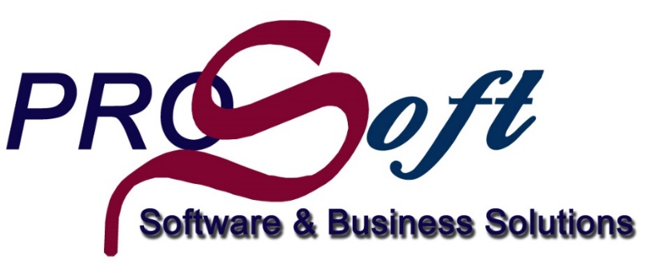

External parties contributing to our success

Slide 26
Conclusion
Whether you choose to adopt a fine grained approach similar to the Britehouse Automotive model or a more coarse grained approach as suggested by Professional services depends on your business requirements
  It is critical to the success of the project to understand your business requirements before you start
  Engage with the professional services team for evaluation and guidance
  Ensure that your technical- and architecture roadmap is closely aligned with your software vendors
Accept and plan for the fact that various complications will be introduced into your software development cycle
A key lesson we’ve learnt, is that anything is possible – ensure that, as with any project, you manage your risks and challenges appropriately
Collaborate with other companies that are in the process of modernization or that have completed some modernization phases of their own
Ensure that “Business” see the benefits and “Buys” into the initiative
There is no silver bullet to solving the problem. Every environment is different and one solution does not fit all

Slide 27
Any Questions?
https://www.progress.com/customers/godrich-toyota-britehouse-automotive

